Slide 1
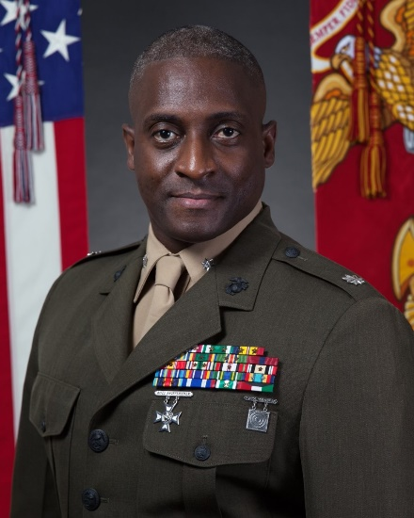
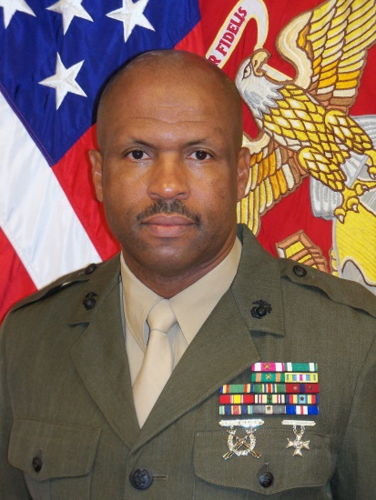
Gar-Field Senior High School MCJROTC Instructional Staff
Lieutenant Colonel Eric W. Kelly Sr., USMC (Ret.)
Senior Marine Instructor
kellye@pwcs.edu
(571) 298-0410
Sergeant Major T. G. Ellis, USMC (Ret.)
Marine Instructor
ellistg@pwcs.edu
(571) 298-0428

